Slide 1
DXC Real Time Projects
Presented by : Mohana Likhitha

Slide 2
The Project is All about?
What is the Project 1 about?
How to tend to the project 1?
What can be achieved from Project 1?
What is the Project 2 about?
How to tend to the Project 2?
What can be achieved from Project 2?

Slide 3
What is Project 1 About?
The Project one is about smart vehicles or connected vehicles. Here, we need to build an architecture to attain the connected vehicles.
What exactly need to be done here:
The vehicle has a third party IOT device which will send the data to AWS cloud in JSON format. We need to move the data from the third party AWS to the company's Azure cloud.

Slide 4
What and Why?
IOT Device | AWS Cloud | Azure Cloud
An IOT device is more like a sensor we are using with the vehicle which here is being used as the data transmitter. | It is an on-demand cloud computing platform which provides the users with many APIs. | Azure cloud is also similar to the AWS cloud, but comparatively, Azure cloud is much more flexible which makes it easier for us to work on our project.

Slide 5
What do we need to do in this Project :
Creating azure data factory
Creating Azure data factory pipeline
Creating blob trigger logic
Creating azure sql server and database
Adding another pipeline to move data from staging to sql database

Slide 6
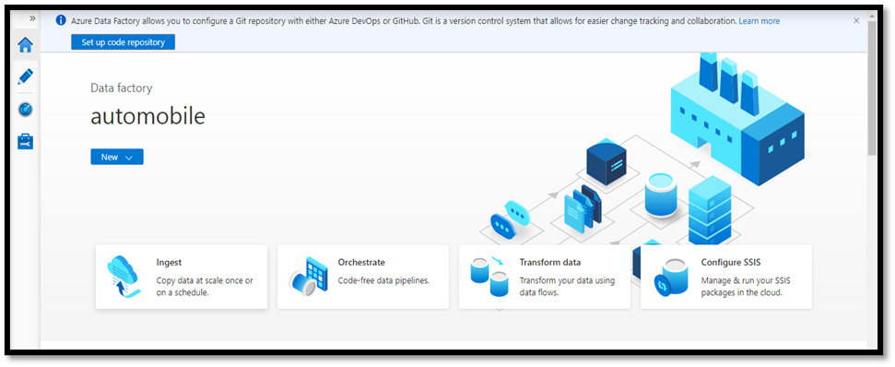
Creating Azure Data Factory (ADF)

Slide 7
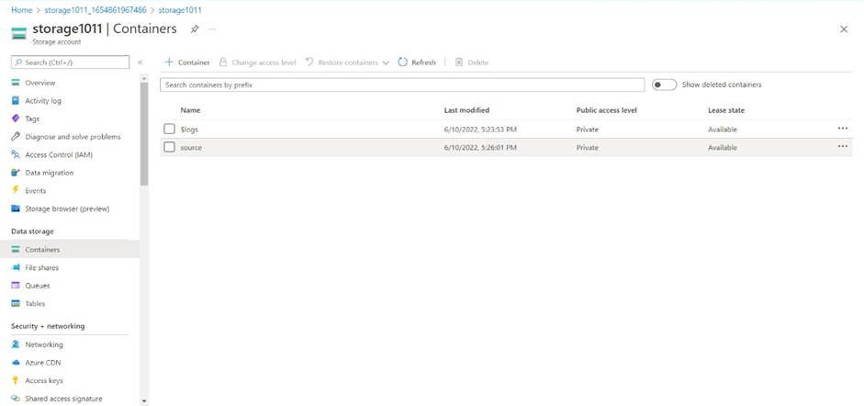
Create an Azure Storage Account with source container and destination container.

Slide 8
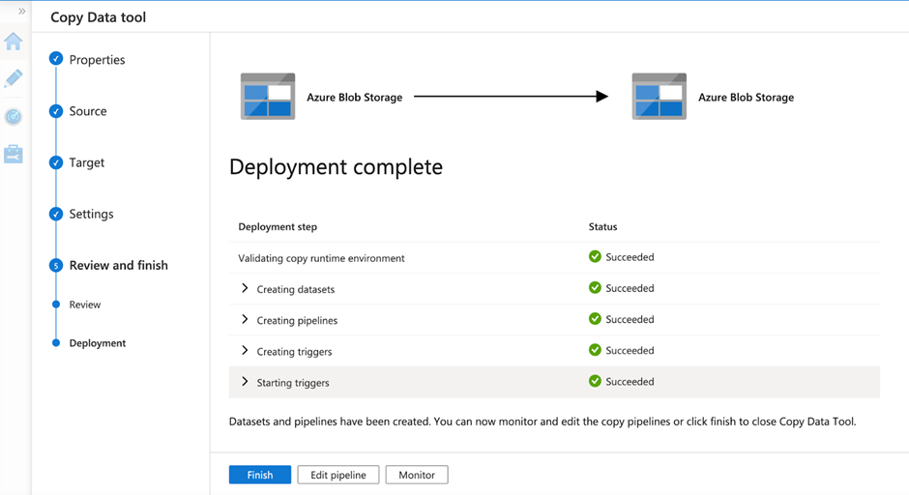
Pipeline Has been Created

Slide 9
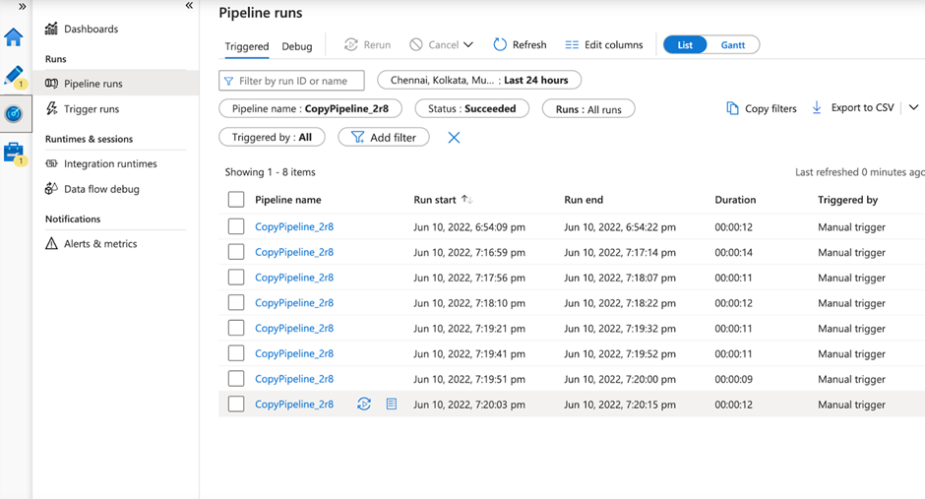
Creating a Blob Trigger

Slide 10
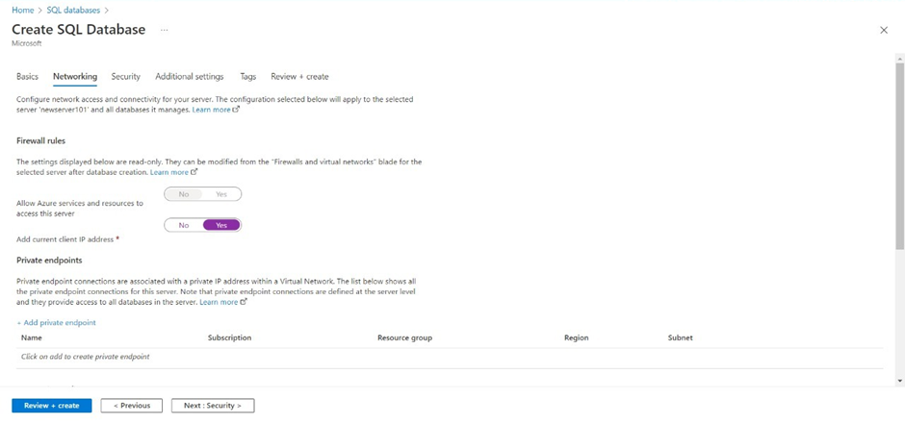
Create SQL server and SQL Database

Slide 11
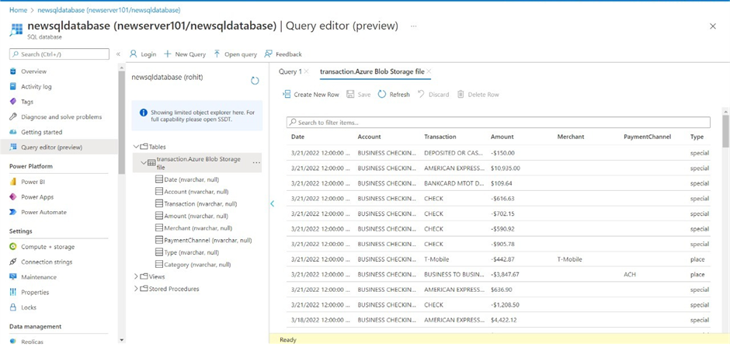
Create another pipeline to move the third-party data to the SQL database.
To check the result, Navigate towards the SQL database and check for the data.

Slide 12
Conclusion
Using the Azure Data Factory, we created a pipeline that will validate and copy the Blob data into the SQL database in this project.
The Blob data has been validated and stored in the SQL database

Slide 13
What is Project 2 About?
Everyday, we will be getting loads and loads of data. But, it is all in CSV format. Usually, in Azure we are going to store it in the Azure Data Lake Storage.
To perform Analytics on this, we need to use Azure Data Bricks.
So basically here, we are storing the CSV data available with us in the delta table created using Data Brick. This whole data is being accessed from a cloud storage space.

Slide 14
What and Why?
CSV Data | Azure Data Lake | Azure Data Bricks
CSV or Comma Separated Values is a tabular data which has been saved as a plain text data that has been separated by commas. | Azure Data Lake is a storage solution based on the Azure Storage Platform. It is an on-demand Analytics job service. | Azure Databricks can be used to read data from various sources available in various formats to perform analytics and create databases.

Slide 15
What do we need to do in this Project :
Create data bricks
Creating the cluster in data bricks
Adding notebook in databricks and Implement BI
Creating data factory
Creating azure data bricks linked service in azure data factory

Slide 16
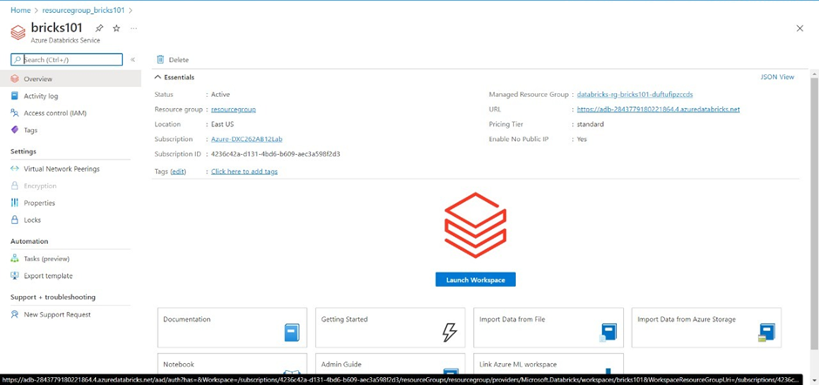
First, create an Azure Databricks workspace

Slide 17
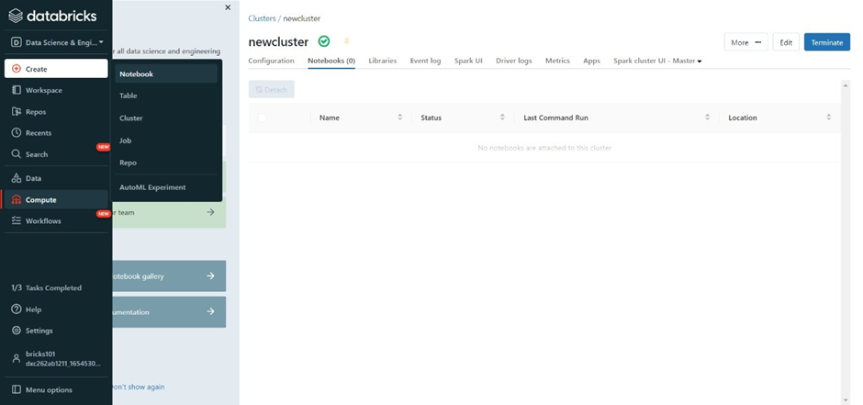
Now, create a cluster

Slide 18
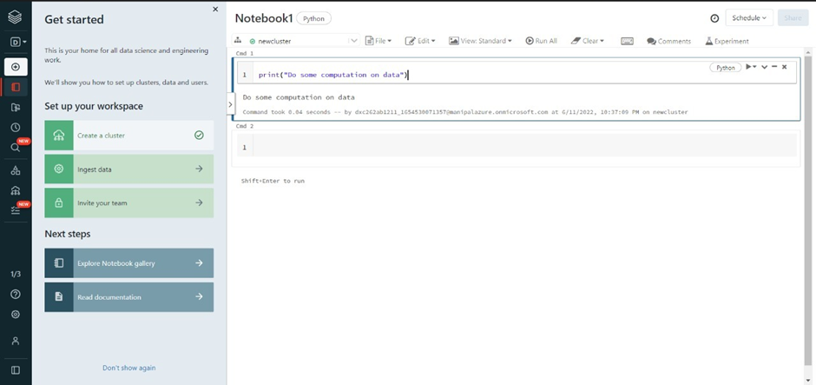
After creating a cluster, create a notebook to work or compute any code

Slide 19
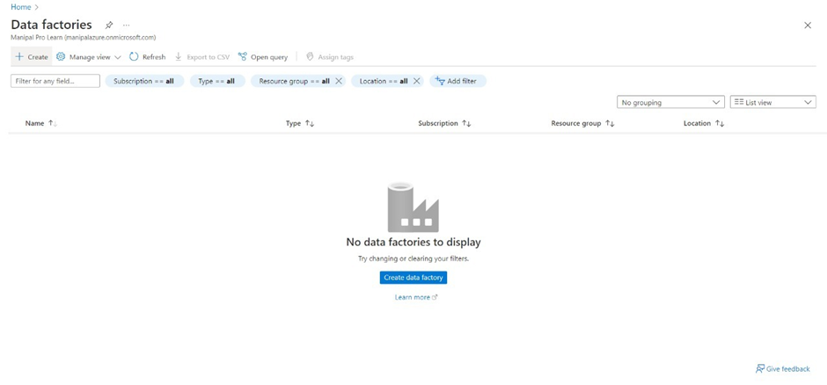
Now, create Azure Data Factory

Slide 20
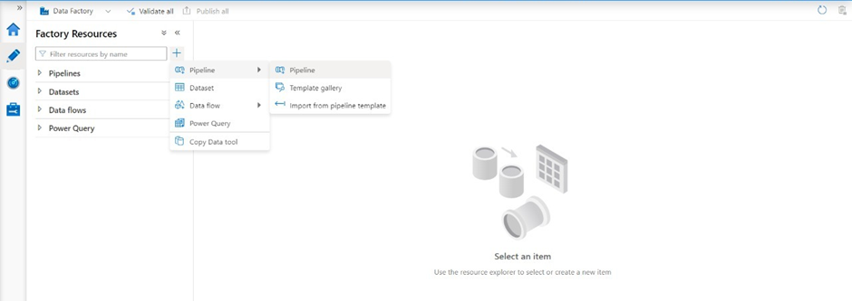
Create a pipeline that will connect Databricks notebook with Data Factory

Slide 21
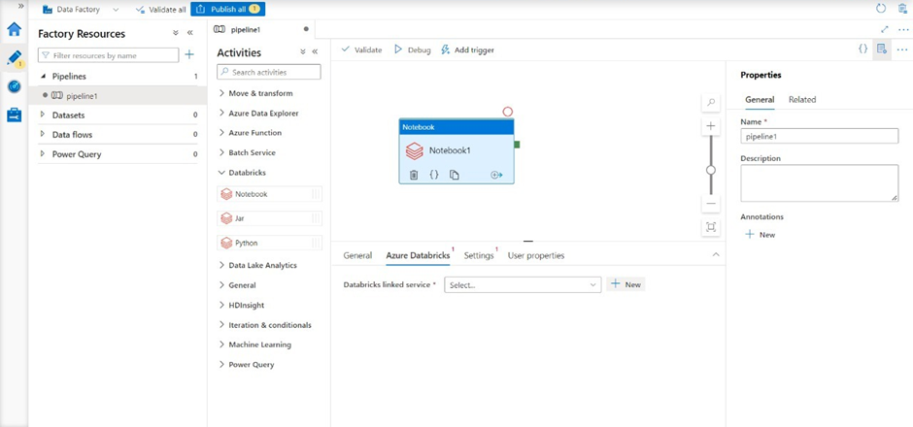
Create a new pipeline and Drag and Drop the notebook tab from Azure Databricks. Dropdown into the pipeline workspace

Slide 22
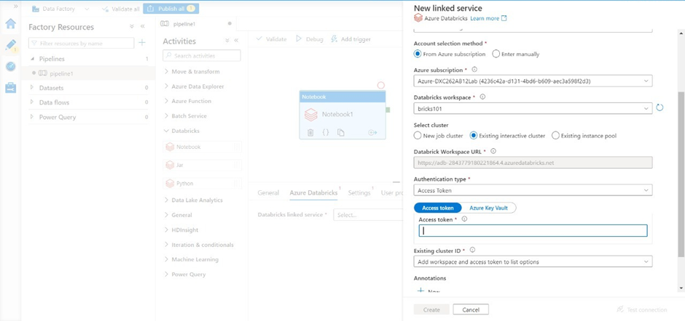
Create a new Linked service for Databricks.

Slide 23
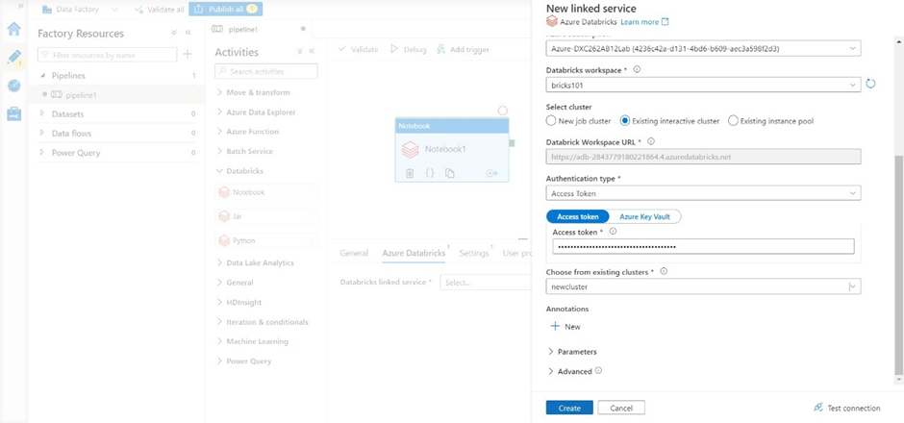
We need the access token of Databricks account in order to access it. Navigate to Databricks workspace and go to Users in settings. Click on “Generate token” and mention a small quick description name for the token. After that a tab will open containing your access token, copy it and paste it in the azure factory data connection form

Slide 24
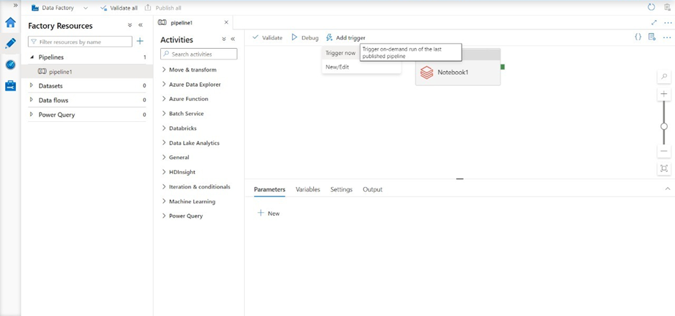
Now choose the notebook in the pipeline notebook tab setting to trigger it. Publish the pipeline to trigger it, after the publication is done, click on “Trigger now”

Slide 25
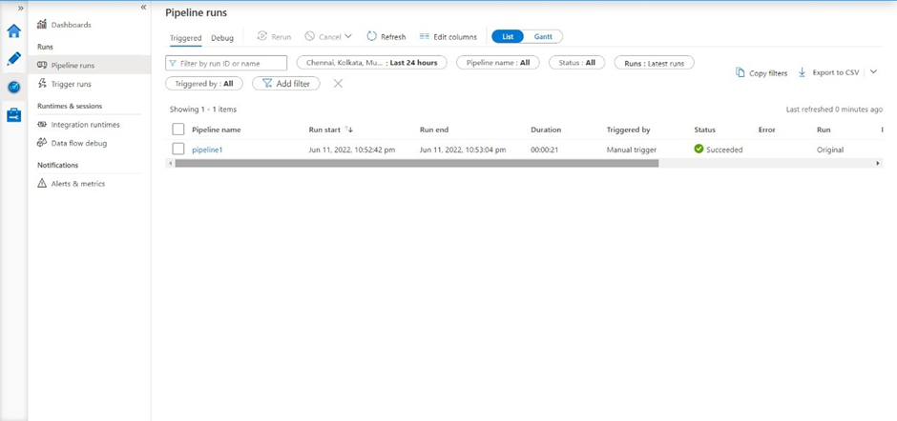
Result: Successfully able to link and trigger Azure DataBricks notebook using Data Factory.

Slide 26
Conclusion
Using Data Factory, we successfully linked and triggered an Azure DataBricks notebook.
Azure Data Factory and Azure Data Bricks are linked.

Slide 27
Thank you

